Slide 1
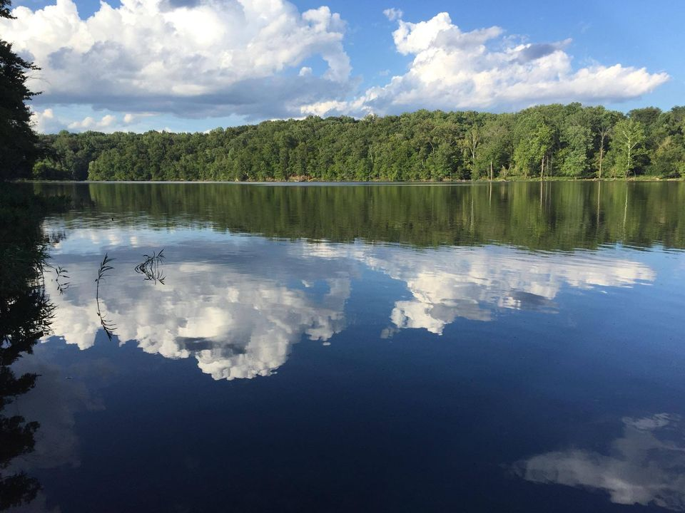
Cannon Bluff Homeowners Association Annual Meeting 2023
Please Sign in and file any proxies with the Secretary

Slide 2
Meeting Decorum
Please wait to be recognized (raise a hand)
Direct comments to the chair
Keep in mind that we’re neighbors, the board are volunteers, and we all have shared interests.
Notes:
-Quorum is 1/10 (4.7 > 5 )

Slide 3
Agenda
Attendance / Decorum
Agenda Review / Corrections
Welcome New Neighbors
Announcements
President’s Report
Treasurer’s Report
Election of Directors (vote for no more than 5)
Adjourn
Notes:
Additions?
-Please allow for efficient completion of the agenda items

Slide 4
A Warm Welcome Our New Neighbors
11242 Caisson Brandon and Crystal Carter
11226 Caisson Stephen and Cynthia Jones
5008 Cannon Bluff Amanda Gonzalez
4920 Lanyard Ashley Humphrey and Litton Dakota
4915 Lanyard Leah and Chun Ning
4925 Wolf Run Shoals Michael and Michelle Ogden
5012 Observer William and Janice Dennis
Notes:
Young – 5926 Yates Ford

Slide 5
Announcements
HOA Address Change
Directory Update
Quickbooks invoicing and online payment option
Stay Connected
Website
Facebook
Nextdoor
Email the Board at Info@cannonbluff.org
Notes:
Young – 5926 Yates Ford

Slide 6
President’s Report
Change in management
Dropped PMI – saves over $6000/yr
Now self managed
Official address:
CBHOA
c.o Carl Lude
10041 Lake Occoquan Dr
Manassas, VA 20111
Unexploded civil war ordnance found on Ramrod
Reserve Study Update (next slide)
Notes:
Spring cleanup
Trash
Lien
Non-payment of dues
Will be updated annually until sale or foreclosure
Only other option is to force a sale
Road preservation
Don’t turn tires
Stay off the sides of the road
Don’t force trucks to the side of the road
Request that heavy trucks (especially tandem axle) back in
Plowing
Custom Care
-per visit billing
-sand
Google Drive
All documents except lot specific lot documents
E-mail secretary
House Fire
Neighborhood pitched in to assist

Slide 7
Reserve Study Summary
Recommended Reserve Funding: We recommend the following in order to achieve a stable and equitable Cash Flow Methodology Funding Plan:
Phased increases of approximately $4,400 from 2024 through 2027
Reduced stable contributions of $10,000 from 2028 through 2030
Decrease to $4,800 by 2031 due to fully funding for replacement of asphalt pavement
Initial adjustment in Reserve Contributions of $4,450 represents an average annual increase of $18.86 per homeowner and about a twenty-six percent (26.1%) adjustment in the 2023 total Operating Budget of $17,052.

Slide 8
Treasurer’s Report
Operating account balance (Checking) = $11,463.49
Capital Account
$10,000 in 6-month CD
$25,000 in 12-month CD
All dues FY23 dues have been paid and all back dues have been collected – thank you to all
Dues for FY 2024 (begins October 1, 2023) will be $78 per year
Notes:
Laurel

Slide 9
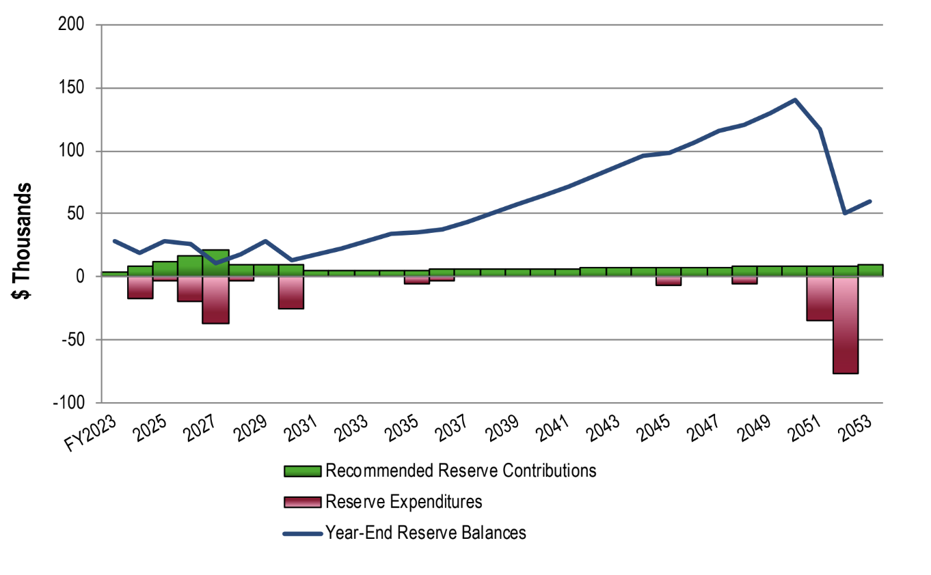
Expenditures recommended by engineering team based on inspection
Long range projections based on expected useful life of asset and future inflation
Dues increase is necessary to meet near term funding goals

Slide 10
Total Income | $17,052.00
Park Maintenance | $10,400.00
Routine Maintenance | $2,500.00
Contingency (storm damage)* | $1,500.00
Repairs | $600.00
Reserve Funding | $3,450.00
Reserve Study | $2,350.00
Management & Administrative Expenses | $6,652.00
Tax Prep | $325.00
CPA Services | $2,700.00
Quickbooks | $300.00
Insurance | $2,000.00
Printing/Postage/Envelopes | $1,020.00
Misc. (Zoom, Google drive, etc) | $167.00
Licenses/Permits/Fees | $140.00
Total Expenses | $17,052.00
FY23 Budget
FY23
CPA ($2,700) replaced PMI management ($5,500)
Savings $2,800
FY24
Next year we’ll be fully self managed ($0)
Savings $2,700
FY24
Requesting members elect to receive official HOA correspondence via email
Savings Potential $1,020
Notes:
Adopted by board

Slide 11
Election of Board Members
Slate of Nominees
Nominations from the floor
Vote (vote for no more than 5)
Results will be posted to the website
Notes:
Vote by secret ballot or motion to accept the slate
Use poll to secretary
Officers appointed at first board meeting

Slide 12
Adjourn
Please drive safe
Slow down for children, dog walkers and turtles :-)

