Slide 1
Asdee Lane Farm

Slide 2
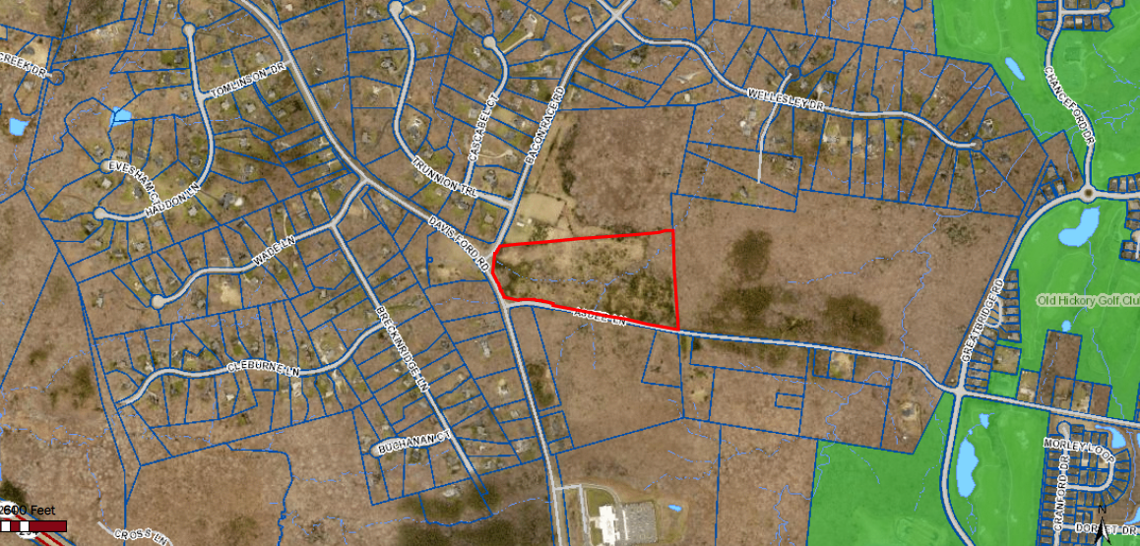
Marsters Property
Howell Tract
Sheep Farm
County Parkland

Slide 3
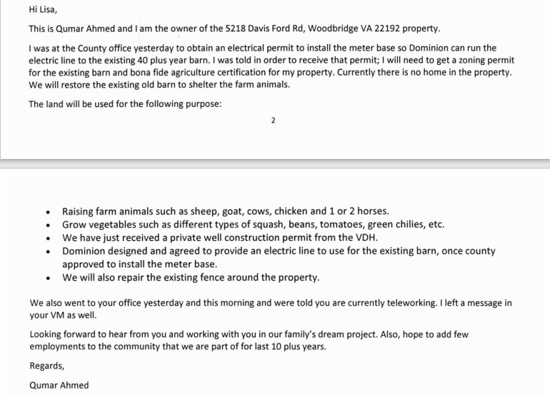
Letter of intent from the owner
Plans to raise animals such as sheep, goats, cows, chickens and 1-2 horses

Slide 4
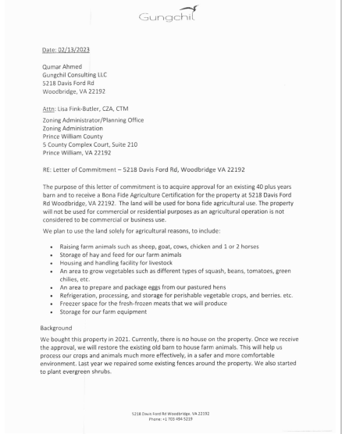
Letter of commitment from the owner for Bona-Fide Agricultural Use- part 1

Slide 5
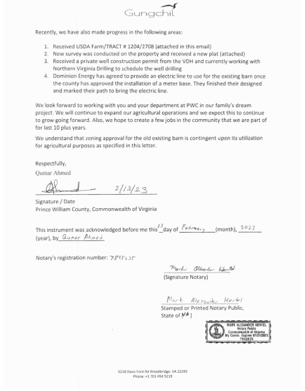
Letter of commitment part 2
Received USDA approval for agricultural operation

Slide 6
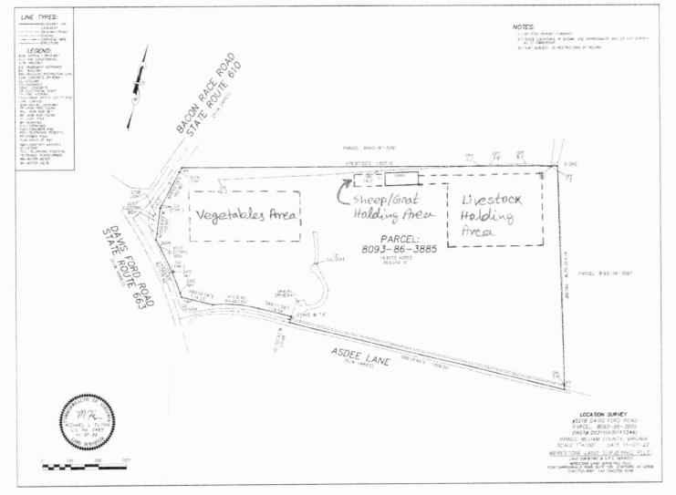
Layout of the operation
Barn already exists and has been expanded
Power has been run to the property
Well has been drilled
Main entrance on Asdee Lane

Slide 7
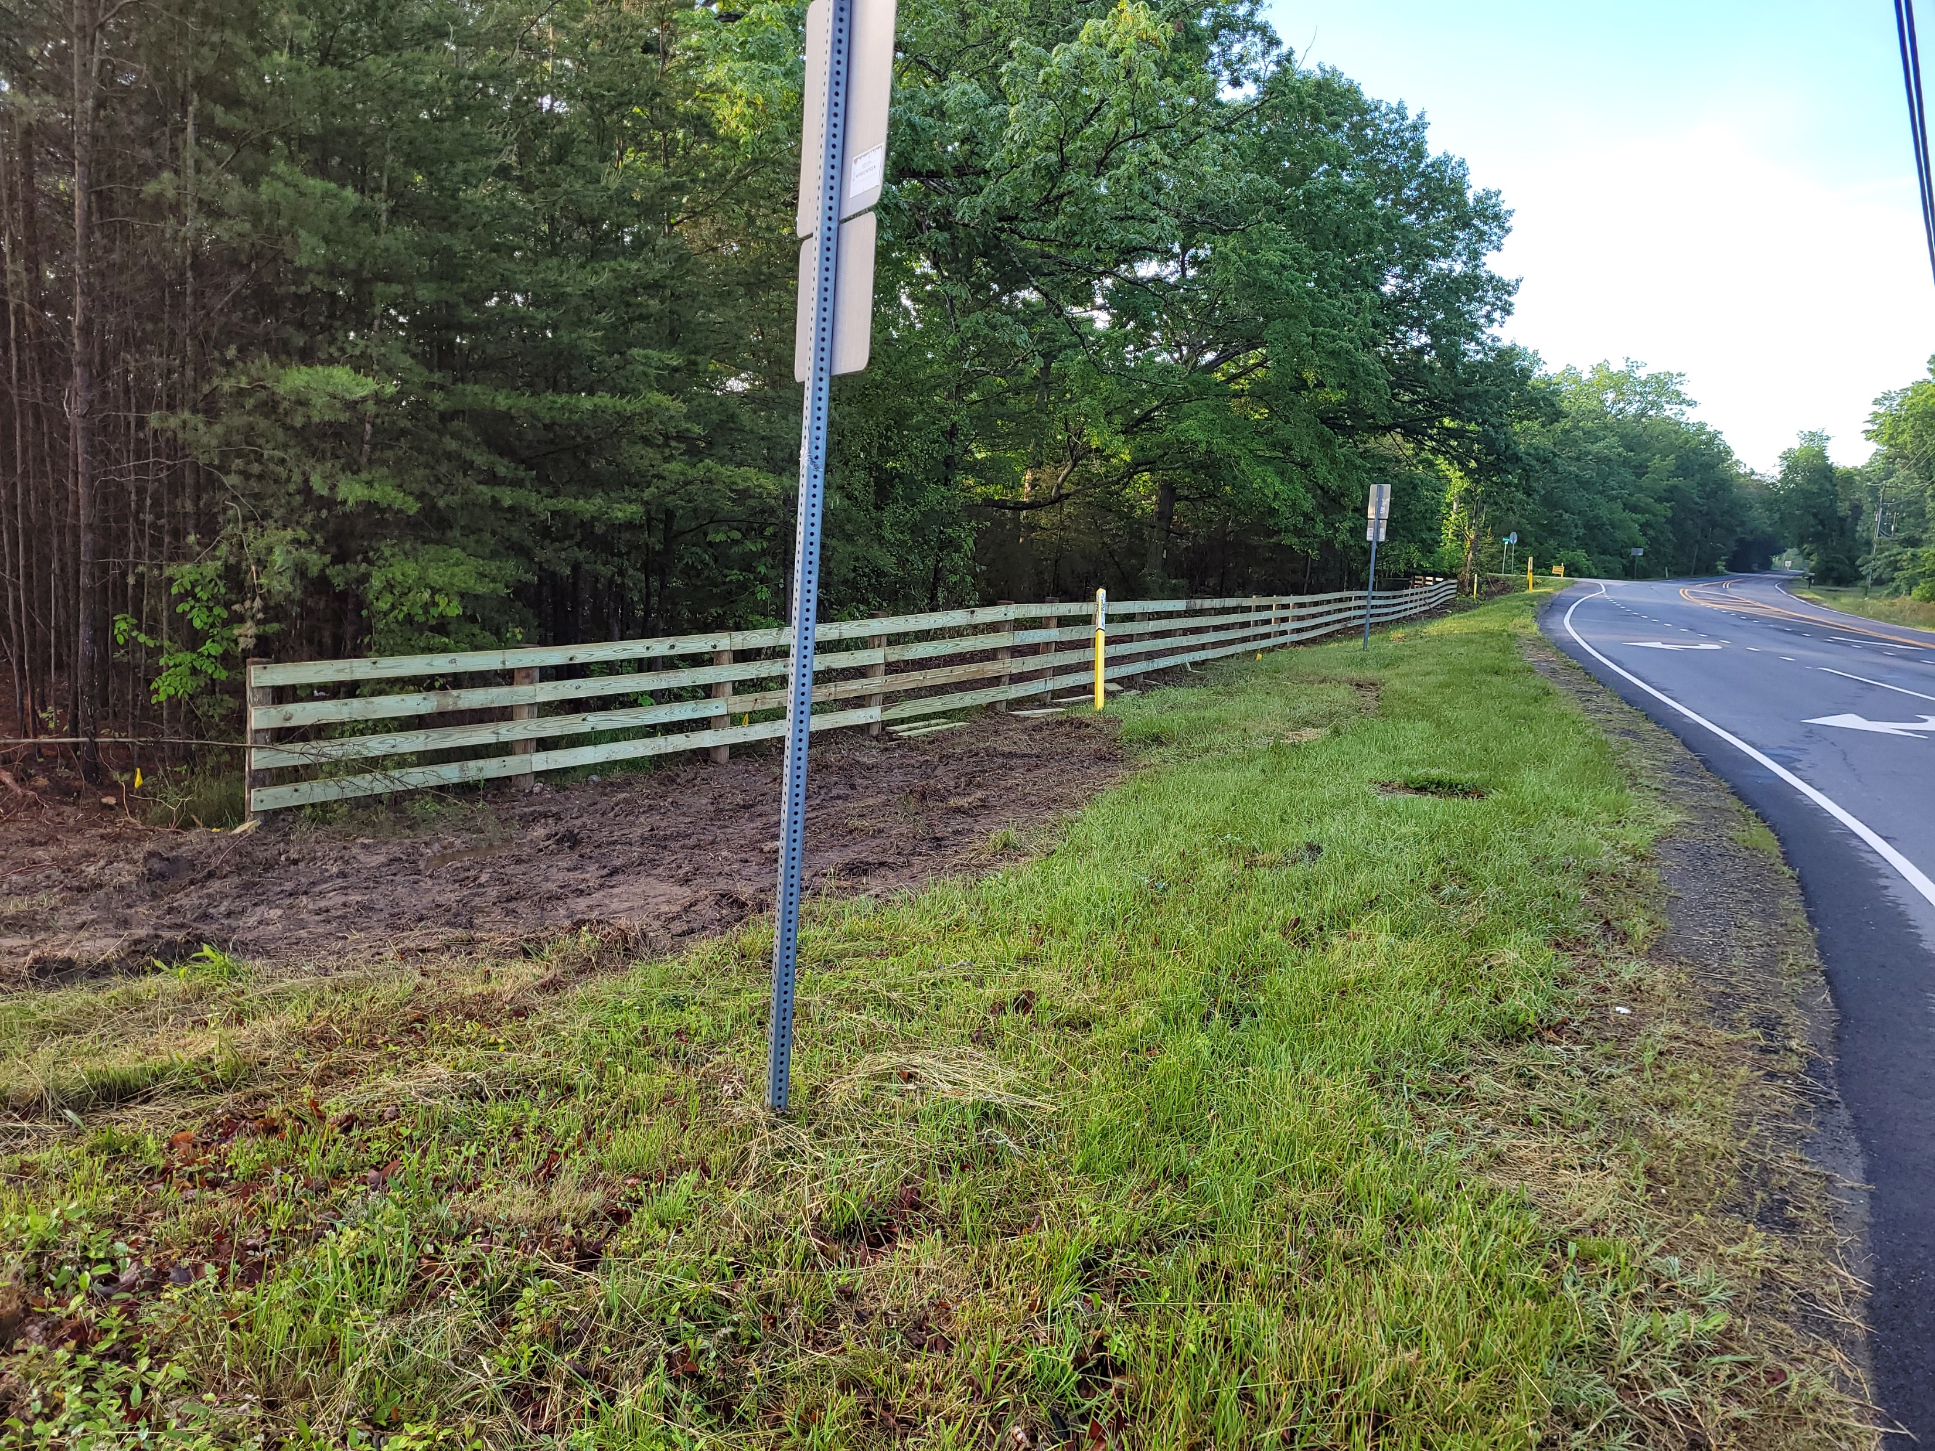

Slide 8
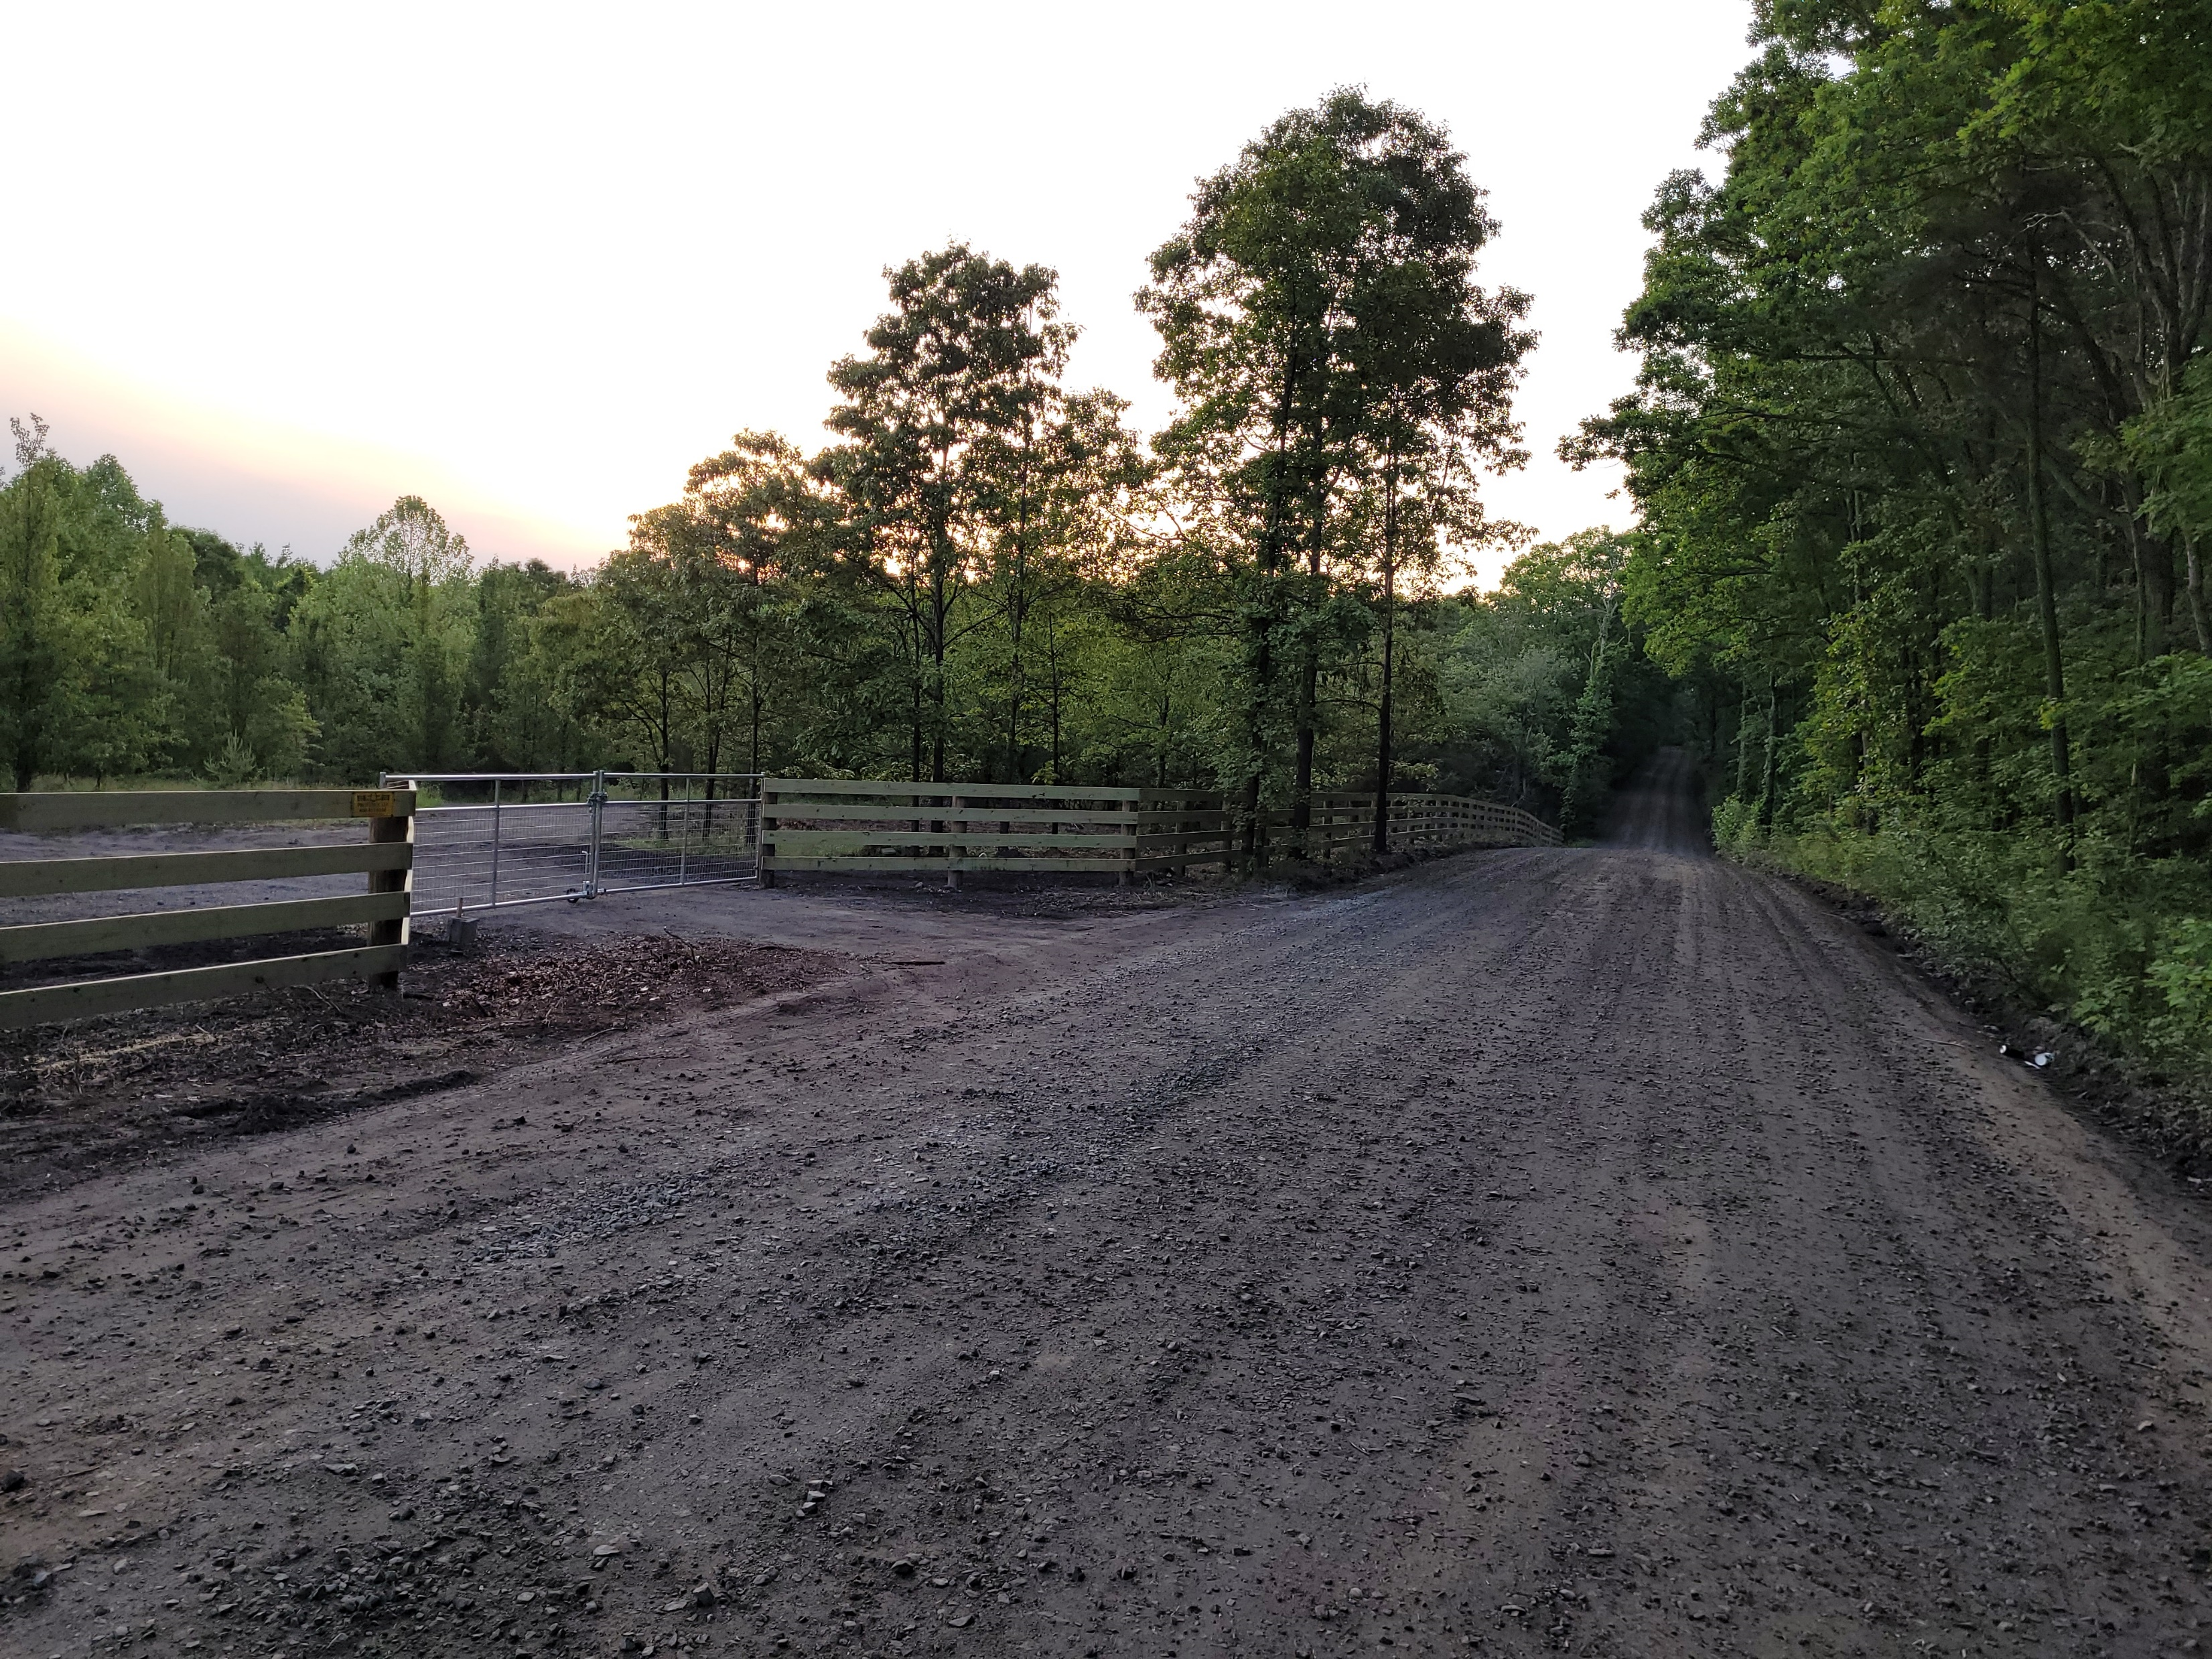
Main entrance

Slide 9
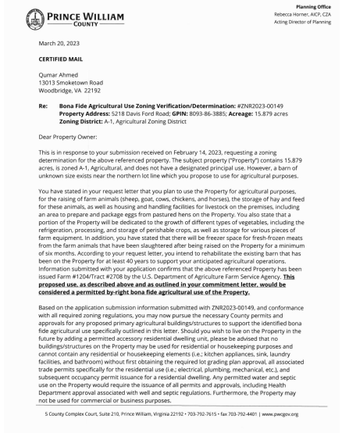
Letter from the county regarding Bona Fide Agricultural Use- part 1
Owner plans to have freezer space for animals slaughtered on-site
There are no apparent restrictions on number of animals processed

Slide 10
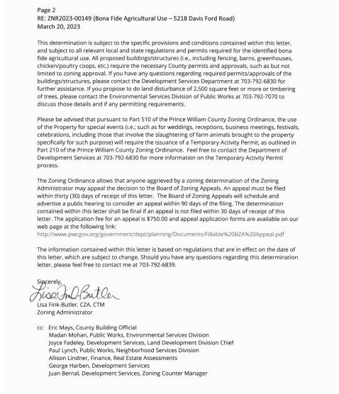
County Bona Fide letter -part 2
For animals on the property less than six months, a Temporary Activity Permit is required
Six permits per year are allowed
One “event” per permit
If there’s a problem, a one-year moratorium can be imposed

Slide 11
Farm is a By-right use on an A-1 zoned property
Has Bona-Fide Agricultural Use approval from the county
Allowed to slaughter animals kept on the property for more than six months
Allowed to slaughter animals kept on the property less than six months with a Temporary Activity Permit (TAP)
One “event” per TAP
Six TAP’s per year
One-year moratorium may be placed on TAP for violations
No apparent restrictions on number of animals processed

Slide 12
Contacts
Midcopw.net
midcopw@gmail.com
*PWC Zoning Administrator Lisa Fink-Butler: lfinkbutler@pwcgov.org, 703-792-6839
U.S. Department of Agriculture Farm Service Agency (540)-347-4402
*Virginia Farm Bureau 540-739-0103
Va. Health Department 703-792-7300

Slide 13
Questions??

