Slide 1
Invasives
Thomas Bolles
Extension Agent, ANR
VCE- Prince William County
Promoting Responsible Land Management, Providing Education and Protecting Water Quality
Virginia Cooperative Extension programs and employment are open to all, regardless of age, color, disability, gender, gender identity, gender expression, national origin, political affiliation, race, religion, sexual orientation, genetic information, veteran status, or any other basis protected by law. An equal opportunity/affirmative action employer. Issued in furtherance of Cooperative Extension work, Virginia Polytechnic Institute and State University, Virginia State University, and the U.S. Department of Agriculture cooperating. Edwin J. Jones, Director, Virginia Cooperative Extension, Virginia Tech, Blacksburg; M. Ray McKinnie, Administrator, 1890 Extension Program, Virginia State University, Petersburg.

Slide 2
Native Species
Non-native
Species
Invasive Species
Occur naturally without human intervention
On North America prior to European settlement
Have natural checks/balances for growth
Introduced
Many have economic value for agriculture, forestry, horticulture
Pose little or no threat to natural ecosystems
Reproduce rapidly
Spread over large areas of landscape
Few, if any, natural controls
Often threaten native species

Slide 3
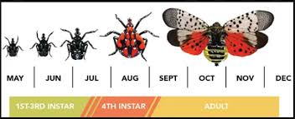
Select Invasive Insects of Concern
Spongy Moth (previously Gypsy Moth)
Emerald Ash Borer
Asian Longhorn Beetle
Spotted Lanternfly
Brown Marmorated Stink Bug
Asian Tiger Mosquito

Slide 4
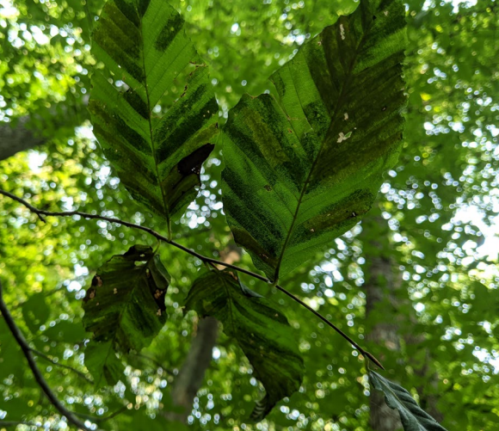
Select Invasive Diseases of Concern
Dutch Elm Disease
Thousand Canker Disease
Beech Leaf Disease
Beech is the most populous tree in PWC

Slide 5
Invasive Plants
In most cases, there is a native alternative
A number of invasives as sold in nurseries
The governor just vetoed a measure that would make it more difficult to sell invasives in Virginia

Slide 6
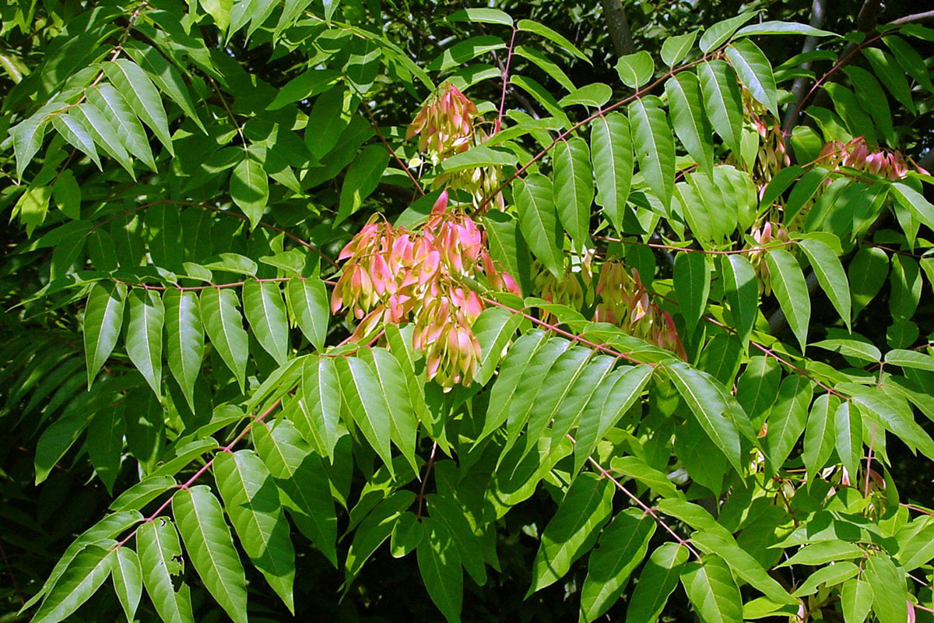
Selected Invasive Trees of Concern
Tree of Heaven
Norway Maple
Bradford Pear
Mimosa
Autumn Olive
Princess Tree

Slide 7
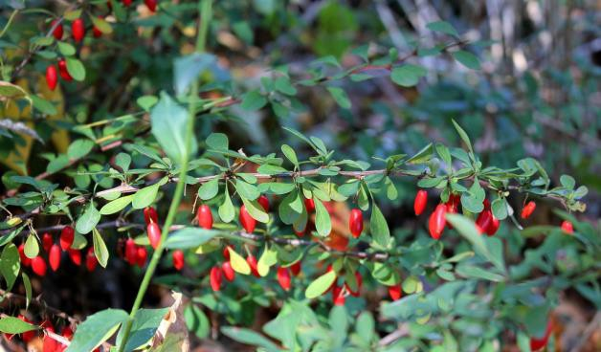
Selected Invasive Shrubs of Concern
Nandina
Burning Bush
Japanese Barberry
Japanese Spirea
Privet
Multiflora Rose
Butterfly Bush

Slide 8
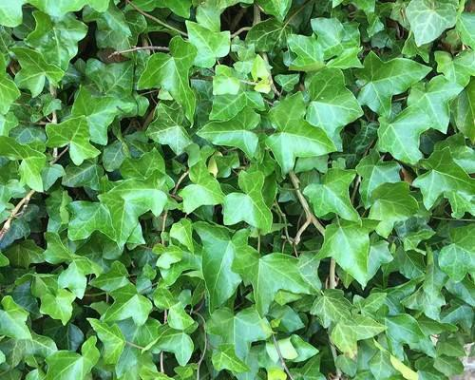
Selected Invasive Vines of Concern
Japanese Honeysuckle
Wisteria
English Ivy
Mile a Minute
Porcelain Berry
Oriental Bittersweet
Autumn Clematis
Kudzu

Slide 9
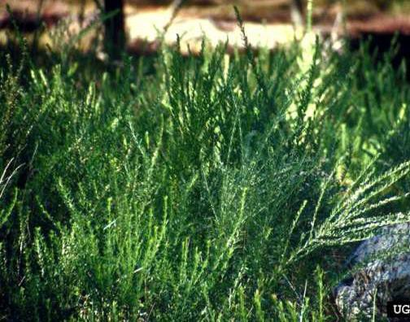
Selected Invasive Perennials of Concern
Vinca (periwinkle)
Crown Vetch
Japanese Knotweed
Chinese Lespedeza
Garlic Mustard

Slide 10
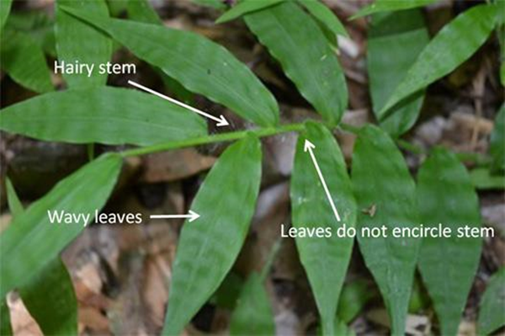
Selected Invasive Grasses of Concern
Running Bamboos
Japanese Stiltgrass
Miscanthus (Maidengrass)
Wavy Leaf Basketgrass

Slide 11
Native Options to Invasives
Vines: Celastrus scandens (American bittersweet), Lonicera sempervirens (Coral Honeysuckle), Gelsemium sempervirens (Carolina jessamine) Decumaria Barbara (climbing Hydrangea) Clematis virginiana
Trees and Shrubs: Oxydendrum arboretum (Sourwood), Hamamelis virginiana (Witch hazel), Aesculus pavia (Red Buckeye), Cercis canadensis (Redbud), Magnolia virginiana (Sweet Bay Magnolia), Malus (crabapple), Chionanthus virginicus (Fringe Tree), Cladrastis kentukea(Yellow Wood), etc.

Slide 12
Native and Non-Native Options to Invasives
Groundcovers: Carex (Sedges) Achillea millefolium (Yarrow), Anthemis nobilis (Chamomile), Violas, Sedums, Woolly and Creeping Red Thyme, Creeping Mazus, Antennaria (Pussytoes)
Grasses: Nimblewill, Creeping Red Fescue, Indian Grass, Switchgrass, Little Bluestem, Big Bluestem

Slide 13
Resources
From The Department of Conservation and Recreation
dcr.virginia.gov/natural-heritage/document/nh-invasive-plant-list-2023.pdf
dcr.virginia.gov/natural-heritage/document/pied-nat-plants.pdf
dcr.virginia.gov/natural-heritage/native-plants-finder
From Plant Nova Natives
plantnovanatives.org/_files/ugd/9c55f5_1d2d3e0424f0420dacbfc78a48acfb41.pdf
US Fish and Wildlife Service:
fws.gov/sites/default/files/documents/native-plants-for-wildlife-habitat-and-conservation-landscaping-in-the-chesapeake-bay-watershed.pdf

Slide 14
Controlling Invasives
Start with the least harmful options for human and environmental health
Make Sure You Properly ID the Invasive
Don’t buy them
Physically remove them
Work with neighbors for unity of effort
Where pesticides are necessary, use the right product at the right time

Slide 15
What Else Can I Do?
Maintain healthy, vigorous plants
Soil test
Fertilize with an appropriate amount at the appropriate time of year
Ensure you have the right plant in the right place
Build the soil (minimize soil disturbance, maximize diversity, keep the soil covered, maximize living roots)
Don’t force plants to bend to your schedule
Take an ecosystem approach

Slide 16
Questions?

